Slide 1


Chapter 7
Network Flow
Slides by Kevin Wayne.
Copyright © 2005 Pearson-Addison Wesley.
All rights reserved.

Slide 2
7.5 Bipartite Matching

Slide 3
Matching
Matching.
  Input: undirected graph G = (V, E).
  M ⊆ E is a matching if each node appears in at most one edge in M.
  Max matching: find a max cardinality matching.

Slide 4
Bipartite Matching
Bipartite matching.
  Input: undirected, bipartite graph G = (L ∪ R, E).
    bipartite graph (or bigraph) is a graph whose vertices can be divided into two disjoint sets (U and V) such that every edge connects a vertex in U to one in V.
  M ⊆ E is a matching if each node appears in at most one edge in M.
  Max matching: find a max cardinality matching.
1
1'
matching
1-2', 3-1', 4-5'
2
2'
3
3'
4
4'
L
5
5'
R

Slide 5
Bipartite Matching
Bipartite matching.
  Input: undirected, bipartite graph G = (L ∪ R, E).
  M ⊆ E is a matching if each node appears in at most edge in M.
  Max matching: find a max cardinality matching.
1
1'
2
2'
max matching
1-1', 2-2', 3-3' 4-4'
3
3'
4
4'
L
5
5'
R

Slide 6
Bipartite Matching
Max flow formulation.
  Create digraph G' = (L ∪ R ∪ {s, t}, E' ).
  Direct all edges from L to R, and assign infinite (or unit) capacity.
  Add source s, and unit capacity edges from s to each node in L.
  Add sink t, and unit capacity edges from each node in R to t.
G'
1
∞
1'
1
2
2'
1
s
3
3'
t
4
4'
L
5
5'
R

Slide 7
Bipartite Matching: Proof of Correctness
Theorem. Max cardinality matching in G = value of max flow in G'.
Pf. ≤
  Given max matching M of cardinality k.
  Consider flow f that sends 1 unit along each of k paths.
  f is a flow, and has cardinality k. ▪
1
1'
1
∞
1'
2
2'
1
2
2'
1
3
3'
s
3
3'
t
4
4'
4
4'
G
G'
5
5'
5
5'

Slide 8
Bipartite Matching: Proof of Correctness
Theorem. Max cardinality matching in G = value of max flow in G'.
Pf. ≥
  Let f be a max flow in G' of value k.
  Integrality theorem ⇒ k is integral and can assume f is 0-1.
  Consider M = set of edges from L to R with f(e) = 1.
    each node in L and R participates in at most one edge in M
    |M| = k: consider cut (L ∪ s, R ∪ t) ▪
1
∞
1'
1
1'
1
2
2'
1
2
2'
s
3
3'
t
3
3'
4
4'
4
4'
G'
G
5
5'
5
5'
Notes:
flow across cut (L ∪ s, R ∪ t) = flow entering t = k

Slide 9
Perfect Matching
Def. A matching M ⊆ E is perfect if each node appears in exactly one edge in M.
Q. When does a bipartite graph have a perfect matching?
Structure of bipartite graphs with perfect matchings.
  Clearly we must have |L| = |R|.
  What other conditions are necessary?
  What conditions are sufficient?

Slide 10
Perfect Matching
Notation. Let S be a subset of nodes, and let N(S) be the set of nodes adjacent to nodes in S.
Observation. If a bipartite graph G = (L ∪ R, E), has a perfect matching, then |N(S)| ≥ |S| for all subsets S ⊆ L.
Pf. Each node in S has to be matched to a different node in N(S).
1
1'
2
2'
No perfect matching:
S = { 2, 4, 5 }
N(S) = { 2', 5' }.
3
3'
4
4'
L
5
5'
R

Slide 11
Marriage Theorem
Marriage Theorem. [Frobenius 1917, Hall 1935] Let G = (L ∪ R, E) be a bipartite graph with |L| = |R|. Then, G has a perfect matching iff |N(S)| ≥ |S| for all subsets S ⊆ L.
Pf. ⇒ This was the previous observation.
1
1'
2
2'
No perfect matching:
S = { 2, 4, 5 }
N(S) = { 2', 5' }.
3
3'
4
4'
L
5
5'
R

Slide 12
Proof of Marriage Theorem
Pf. ⇐ Suppose G does not have a perfect matching.
  Formulate as a max flow problem and let (A, B) be min cut in G'.
  By max-flow min-cut, cap(A, B) < | L |.
  Define L_{A} = L ∩ A, L_{B} = L ∩ B , R_{A} = R ∩ A.
  cap(A, B) = | L_{B} | + | R_{A} |.
  Since min cut can't use ∞ edges: N(L_{A}) ⊆ R_{A}.
  |N(L_{A} )| ≤ | R_{A} | = cap(A, B) - | L_{B} | < | L | - | L_{B} | = | L_{A} |.
    Choose S = L_{A} , conflict with assumption ▪
1
∞
∞
G'
1
A
1'
2'
L_{A} = {2, 4, 5}
L_{B} = {1, 3}
R_{A} = {2', 5'}
N(L_{A}) = {2', 5'}
2
∞
1
s
1
3'
4
3
4'
t
5
1
5'

Slide 13
Bipartite Matching: Running Time
Which max flow algorithm to use for bipartite matching?
  Generic augmenting path: O(m val(f*) ) = O(mn).
  Capacity scaling: O(m² log C ) = O(m²).
  Shortest augmenting path: O(m n^{1/2}).
Non-bipartite matching.
  Structure of non-bipartite graphs is more complicated, but
  well-understood. [Tutte-Berge, Edmonds-Galai]
  Blossom algorithm: O(n⁴). [Edmonds 1965]
  Best known: O(m n^{1/2}). [Micali-Vazirani 1980]

Slide 14
7.6 Disjoint Paths

Slide 15
Edge Disjoint Paths
Disjoint path problem. Given a digraph G = (V, E) and two nodes s and t, find the max number of edge-disjoint s-t paths.
Def. Two paths are edge-disjoint if they have no edge in common.
Ex: communication networks.
2
5
s
3
6
t
4
7

Slide 16
Edge Disjoint Paths
Disjoint path problem. Given a digraph G = (V, E) and two nodes s and t, find the max number of edge-disjoint s-t paths.
Def. Two paths are edge-disjoint if they have no edge in common.
Ex: communication networks.
2
5
s
3
6
t
4
7

Slide 17
Edge Disjoint Paths
Max flow formulation: assign unit capacity to every edge.
Theorem. Max number edge-disjoint s-t paths equals max flow value.
Pf. ≤
  Suppose there are k edge-disjoint paths P₁, . . . , P_{k}.
  Set f(e) = 1 if e participates in some path P_{i} ; else set f(e) = 0.
  Since paths are edge-disjoint, f is a flow of value k. ▪
1
1
1
1
1
1
s
1
1
t
1
1
1
1
1
1

Slide 18
Edge Disjoint Paths
Max flow formulation: assign unit capacity to every edge.
Theorem. Max number edge-disjoint s-t paths equals max flow value.
Pf. ≥
  Suppose max flow value is k.
  Integrality theorem ⇒ there exists 0-1 flow f of value k.
  Consider edge (s, u) with f(s, u) = 1.
    by conservation, there exists an edge (u, v) with f(u, v) = 1
    continue until reach t, always choosing a new edge
  Produces k (not necessarily simple) edge-disjoint paths. ▪
1
1
1
1
1
1
s
1
1
t
1
1
1
1
1
1
can eliminate cycles to get simple paths if desired

Slide 19
Network Connectivity
Network connectivity. Given a digraph G = (V, E) and two nodes s and t, find min number of edges whose removal disconnects t from s.
Def. A set of edges F ⊆ E disconnects t from s if every s-t path uses at least one edge in F.
2
5
s
3
6
t
4
7

Slide 20
Edge Disjoint Paths and Network Connectivity
Theorem. [Menger 1927] The max number of edge-disjoint s-t paths is equal to the min number of edges whose removal disconnects t from s.
Pf. ≤
  Suppose the removal of F ⊆ E disconnects t from s, and |F| = k.
  Every s-t path uses at least one edge in F.
  Hence, the number of edge-disjoint paths is at most k. ▪
2
5
2
5
s
3
6
t
s
3
6
t
4
7
4
7

Slide 21
Disjoint Paths and Network Connectivity
Theorem. [Menger 1927] The max number of edge-disjoint s-t paths is equal to the min number of edges whose removal disconnects t from s.
Pf. ≥
  Suppose max number of edge-disjoint paths is k.
  Then max flow value is k.
  Max-flow min-cut ⇒ cut (A, B) of capacity k.
  Let F be set of edges going from A to B.
  |F| = k and disconnects t from s. ▪
A
2
5
2
5
s
3
6
t
s
3
6
t
4
7
4
7

Slide 22
7.7 Extensions to Max Flow

Slide 23
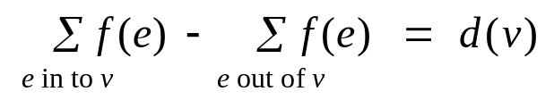
Circulation with Demands
Circulation with demands.
  Directed graph G = (V, E).
  Edge capacities c(e), e ∈ E.
  Node supply and demands d(v), v ∈ V.
Def. A circulation is a function that satisfies:
  For each e ∈ E: 0 ≤ f(e) ≤ c(e) (capacity)
  For each v ∈ V: (conservation)
Circulation problem: given (V, E, c, d), does there exist a circulation?
demand if d(v) > 0; supply if d(v) < 0; transshipment if d(v) = 0

Slide 24
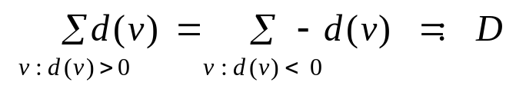
Circulation with Demands
Necessary condition: sum of supplies = sum of demands.
Pf. Sum conservation constraints for every demand node v.
-8
-6
supply
6
1
4
7
7
7
10
6
6
4
2
9
-7
3
3
4
11
10
0
4
capacity
demand
flow
Notes:
note: only one type of flow (indistinguishable whether it is received from one source or another)
more general problem: multicommodity flow, where each sink must receive flow from one particular source

Slide 25
Circulation with Demands
Max flow formulation.
-8
-6
supply
G:
7
7
10
6
4
9
-7
3
4
11
10
0
demand

Slide 26
Circulation with Demands
Max flow formulation.
  Add new source s and sink t.
  For each v with d(v) < 0, add edge (s, v) with capacity -d(v).
  For each v with d(v) > 0, add edge (v, t) with capacity d(v).
  Claim: G has circulation iff G' has max flow of value D.
saturates all edges
leaving s and entering t
s
7
8
6
supply
G':
7
7
10
6
4
9
3
4
0
10
11
demand
t

Slide 27
Circulation with Demands
Integrality theorem. If all capacities and demands are integers, and there exists a circulation, then there exists one that is integer-valued.
Pf. Follows from max flow formulation and integrality theorem for max flow.
Characterization. Given (V, E, c, d), there does not exists a circulation iff there exists a node partition (A, B) such that Σ_{v∈B} d_{v} > cap(A, B)
Pf idea. Look at min cut in G'.
demand by nodes in B exceeds supply
of nodes in B plus max capacity of
edges going from A to B

Slide 28
Circulation with Demands and Lower Bounds
Feasible circulation.
  Directed graph G = (V, E).
  Edge capacities c(e) and lower bounds  (e), e ∈ E.
  Node supply and demands d(v), v ∈ V.
Def. A circulation is a function that satisfies:
  For each e ∈ E:  (e) ≤ f(e) ≤ c(e) (capacity)
  For each v ∈ V: (conservation)
Circulation problem with lower bounds. Given (V, E, , c, d), does there exists a a circulation?

Slide 29
Circulation with Demands and Lower Bounds
Idea. Model lower bounds with demands.
  Send (e) units of flow along edge e.
  Update demands of both endpoints.
Theorem. There exists a circulation in G iff there exists a circulation in G'. If all demands, capacities, and lower bounds in G are integers, then there is a circulation in G that is integer-valued.
Pf sketch. f(e) is a circulation in G iff f'(e) = f(e) - (e) is a circulation in G'.
lower bound
upper bound
capacity
v
[2, 9]
w
v
7
w
d(v)
G
d(w)
d(v) + 2
d(w) - 2
G'

Slide 30
7.8 Survey Design

Slide 31
Survey Design
one survey question per product
Survey design.
  Design survey asking n₁ consumers about n₂ products.
  Can only survey consumer i about product j if they own it.
  Ask consumer i between c_{i} and c_{i}' questions.
  Ask between p_{j} and p_{j}' consumers about product j.
Goal. Design a survey that meets these specs, if possible.
Bipartite perfect matching. Special case when c_{i} = c_{i}' = p_{i} = p_{i}' = 1.

Slide 32
Survey Design
Algorithm. Formulate as a circulation problem with lower bounds.
  Include an edge (i, j) if consumer i owns product j.
  Integer circulation ⇔ feasible survey design.
    Flow on (t,s) is equal to overall # of questions asked
    All nodes have demand of 0
[0, ∞]
[∑ ci, ∑ ci’]
1
[0, 1]
1'
[c₁, c₁']
[p₁, p₁']
2
2'
s
3
3'
t
4
4'
consumers
5
5'
products

Slide 33
7.10 Image Segmentation

Slide 34
Image Segmentation
Image segmentation.
  Central problem in image processing.
  Divide image into coherent regions.
Ex: Three people standing in front of complex background scene. Identify each person as a coherent object.

Slide 35
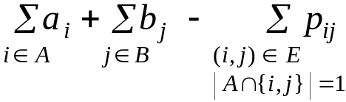
Image Segmentation
Foreground / background segmentation.
  Label each pixel in picture as belonging to
  foreground or background.
  V = set of pixels, E = pairs of neighboring pixels.
  a_{i} ≥ 0 is likelihood pixel i in foreground.
  b_{i} ≥ 0 is likelihood pixel i in background.
  p_{ij} ≥ 0 is separation penalty for labeling one of i
  and j as foreground, and the other as background.
Goals.
  Accuracy: if a_{i} > b_{i} in isolation, prefer to label i in foreground.
  Smoothness: if many neighbors of i are labeled foreground, we should be inclined to label i as foreground.
  Find partition (A, B) that maximizes:
foreground
background

Slide 36
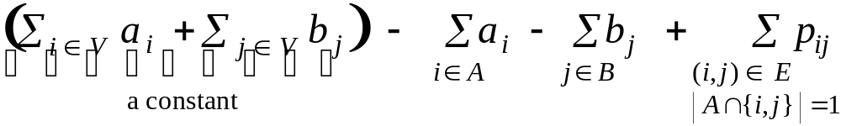
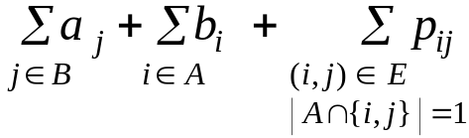
Image Segmentation
Formulate as min cut problem.
  Maximization.
  No source or sink.
  Undirected graph.
Turn into minimization problem.
  Maximizing
  is equivalent to minimizing
  or alternatively

Slide 37
Image Segmentation
Formulate as min cut problem.
  G' = (V', E').
  Add source to correspond to foreground;
  add sink to correspond to background
  Use two anti-parallel edges instead of
  undirected edge.
p_{ij}
p_{ij}
p_{ij}
a_{j}
s
i
p_{ij}
j
t
b_{i}
G'

Slide 38
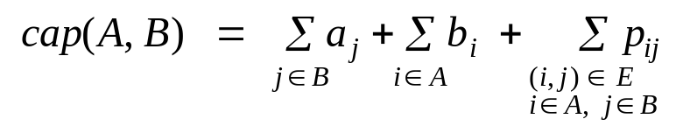
Image Segmentation
Consider min cut (A, B) in G'.
  A = foreground.
  Precisely the quantity we want to minimize.
if i and j on different sides,
p_{ij} counted exactly once
a_{j}
s
i
p_{ij}
j
t
b_{i}
A
G'

Slide 39
7.11 Project Selection

Slide 40
Project Selection
can be positive or negative
Projects with prerequisites.
  Set P of possible projects. Project v has associated revenue p_{v}.
    some projects generate money: create interactive e-commerce interface, redesign web page
    others cost money: upgrade computers, get site license
  Set of prerequisites E. If (v, w) ∈ E, can't do project v and unless also do project w.
  A subset of projects A ⊆ P is feasible if the prerequisite of every project in A also belongs to A.
Project selection. Choose a feasible subset of projects to maximize revenue.
Notes:
project selection = max weight closure problem

Slide 41
Project Selection: Prerequisite Graph
Prerequisite graph.
  Include an edge from v to w if can't do v without also doing w.
  {v, w, x} is feasible subset of projects.
  {v, x} is infeasible subset of projects.
  Easy to find feasible set, but what about max revenue?
w
w
v
x
v
x
feasible
infeasible

Slide 42
Project Selection: Min Cut Formulation
Min cut formulation.
  Assign capacity ∞ to all prerequisite edge.
  Add edge (s, v) with capacity -p_{v} if p_{v} > 0.
  Add edge (v, t) with capacity -p_{v} if p_{v} < 0.
  For notational convenience, define p_{s} = p_{t} = 0.
u
∞
w
∞
p_{u}
∞
-p_{w}
s
p_{y}
y
∞
z
-p_{z}
t
p_{v}
∞
-p_{x}
v
∞
x
∞

Slide 43
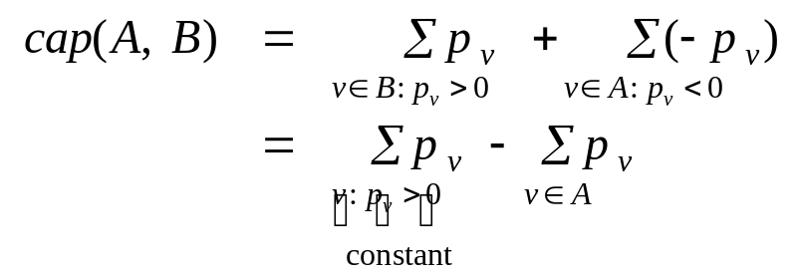
Project Selection: Min Cut Formulation
Claim. (A, B) is min cut iff A − { s } is optimal set of projects.
  Infinite capacity edges ensure A − { s } is feasible.
  Max revenue because:
+ and – all nodes in A that have positive p
w
u
A
p_{u}
-p_{w}
s
p_{y}
y
z
t
p_{v}
∞
-p_{x}
v
∞
x
∞

Slide 44


Project selection application#1: Open Pit Mining
Open-pit mining. (studied since early 1960s)
  Blocks of earth are extracted from surface to retrieve ore.
  Each block v has net value p_{v} = value of ore - processing cost.
  Can't remove block v before w or x.
w
x
v

Slide 45
7.12 Baseball Elimination

Slide 46
Baseball Elimination
Which teams have a chance of finishing the season with most wins?
  Montreal eliminated since it can finish with at most 80 wins, but Atlanta already has 83.
  w_{i} + r_{i} < w_{j} ⇒ team i eliminated.
  Only reason sports writers appear to be aware of.
  Sufficient, but not necessary!
Team
i
Wins
w_{i}
Losses
l_{i}
To play
r_{i}
Against = r_{ij}
Atl
Phi
NY
Mon
Atlanta
83
71
8
-
1
6
1
Philly
80
79
3
1
-
0
2
New York
78
78
6
6
0
-
0
Montreal
77
82
3
1
2
0
-
Notes:
As season unfolds, sports fans are naturally interested in how their favorite teams are doing. Is there some outcome of remaining games in which your favorite team finishes the season with the most (or tied for most) wins?

Slide 47
Baseball Elimination
Which teams have a chance of finishing the season with most wins?
  Philly can win 83, but still eliminated . . .
  If Atlanta loses a game, then some other team wins one.
Remark. Answer depends not just on how many games already won and left to play, but also on whom they're against.
Team
i
Wins
w_{i}
Losses
l_{i}
To play
r_{i}
Against = r_{ij}
Atl
Phi
NY
Mon
Atlanta
83
71
8
-
1
6
1
Philly
80
79
3
1
-
0
2
New York
78
78
6
6
0
-
0
Montreal
77
82
3
1
2
0
-

Slide 48
Baseball Elimination
Baseball elimination problem.
  Set of teams S.
  Distinguished team s ∈ S.
  Team x has won w_{x} games already.
  Teams x and y play each other r_{xy} additional times.
  Is there any outcome of the remaining games in which team s finishes with the most (or tied for the most) wins?

Slide 49
Baseball Elimination: Max Flow Formulation
Can team 3 finish with most wins?
  Assume team 3 wins all remaining games ⇒ w₃ + r₃ wins.
  Find a solution of remaining games so that all teams
  have ≤ w₃ + r₃ wins.
1-2
1
team 4 can still
win this many
more games
1-4
games left
2
1-5
∞
s
r₂₄ = 7
2-4
∞
4
w₃ + r₃ - w₄
t
2-5
5
game nodes
4-5
team nodes

Slide 50
Baseball Elimination: Max Flow Formulation
Theorem. Team 3 is not eliminated iff max flow saturates all edges leaving source s.
  Integrality theorem ⇒ each remaining game between x and y added to number of wins for team x or team y.
  Capacity on (x, t) edges ensure no team wins too many games.
1-2
1
team 4 can still
win this many
more games
1-4
games left
2
1-5
∞
s
r₂₄ = 7
2-4
∞
4
w₃ + r₃ - w₄
t
2-5
5
game nodes
4-5
team nodes

